Slide 1
SNC1P0 – Oct 14 (P3)
Demo – What Is Stuff Made Of?
Chemistry – Periodic Table
Reading The Table - Review
First 20 Elements – Day 1
Video – Hunting The Elements
Upcoming:
T.b.d.

Slide 2
Reading The Periodic Table
Each box on the periodic table represents a different element
It contains vital information about the element
________Number
6 C Carbon 12.011
__________Symbol
Element Name
Atomic ________

Slide 3
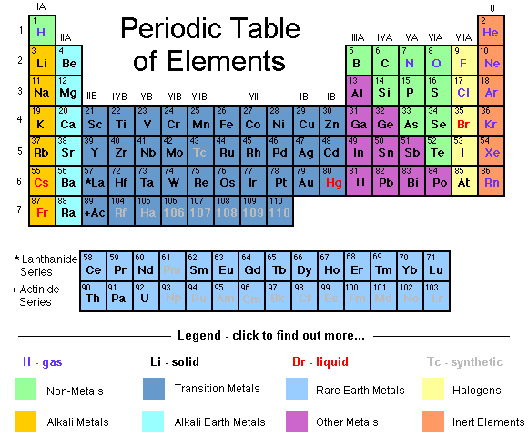

Slide 4
Hunting the Elements – Gold Mine (time: 4:00 – 13:00)
https://www.youtube.com/watch?v=t1ykHeaRqiE
http://htwins.net/scale2/

